Slide 1

College of Technology
Silver Oak College of Engineering and Technology
Bachelor of Technology
Department of Information Technology
Voice
Group Members Detail
Om Bhavsar - 2101031000018
Internal Guide Detail
Prof. Darshan Sagar

Slide 2
Table of Content
Abstract
Introduction
Literature Survey/Research
Study of Current System
Improvement needed in Current System
Features of Proposed System
Object Oriented Diagrams (Flow Chart)
Wireframe
Tools and Technologies used
Worked carried out till date
Timeline Chart(Gantt chart)
Future Work
Conclusion
References

Slide 3
Abstract
The "Voice" project is an e-commerce platform built on the MERN stack, specializing in selling TWS, headphones and smartwatches. The website features a user authentication system using JWT tokens, a secure payment gateway integrated with Stripe, and sections for popular products, latest collections, and customer support. The platform aims to provide a seamless shopping experience with modern technology and a clean, responsive design.

Slide 4
Introduction
"Voice" is an e-commerce website that caters to the growing demand for TWS headphones and smartwatches. The platform provides a user-friendly interface with secure payment options and a seamless checkout process. The site aims to enhance the user experience by showcasing popular products, introducing new launches, and offering customer support through a well-organized support section.

Slide 5
Literature Survey/Research
Research on the current e-commerce landscape shows an increasing shift towards mobile-friendly platforms, integrated payment systems, and personalized user experiences. Major e-commerce sites like Amazon, Flipkart, and niche markets for electronics have set the standards in usability, security, and scalability. Stripe’s secure payment gateway, along with JWT-based authentication, has proven to be the most secure and effective method for user verification and transaction management.

Slide 6
Study of Current System
Existing e-commerce solutions often suffer from high complexity in their user interfaces, inadequate mobile responsiveness, and lack of personalized customer support. While they offer secure payment options, many struggle with fast-loading product galleries and efficient cart management systems.

Slide 7
Improvement needed in Current System
Faster loading times, a more responsive design, easier checkout flow, better integration of secure payment gateways like Stripe, and an efficient system for managing product categories and cart data.

Slide 8
Features of Proposed System
User Authentication: JWT-based secure login/logout system.
Cart Management: Efficient cart operations with MongoDB.
Product Listings: Categories for popular products, new launches, and latest collections.
Responsive Design: Tailwind CSS ensures mobile-friendly and fast-loading pages.
Payment Gateway: Integrated Stripe for secure transactions.
Customer Support: Dedicated support section for post-purchase assistance.
Admin Dashboard: Manage products and categories from the frontend.

Slide 9
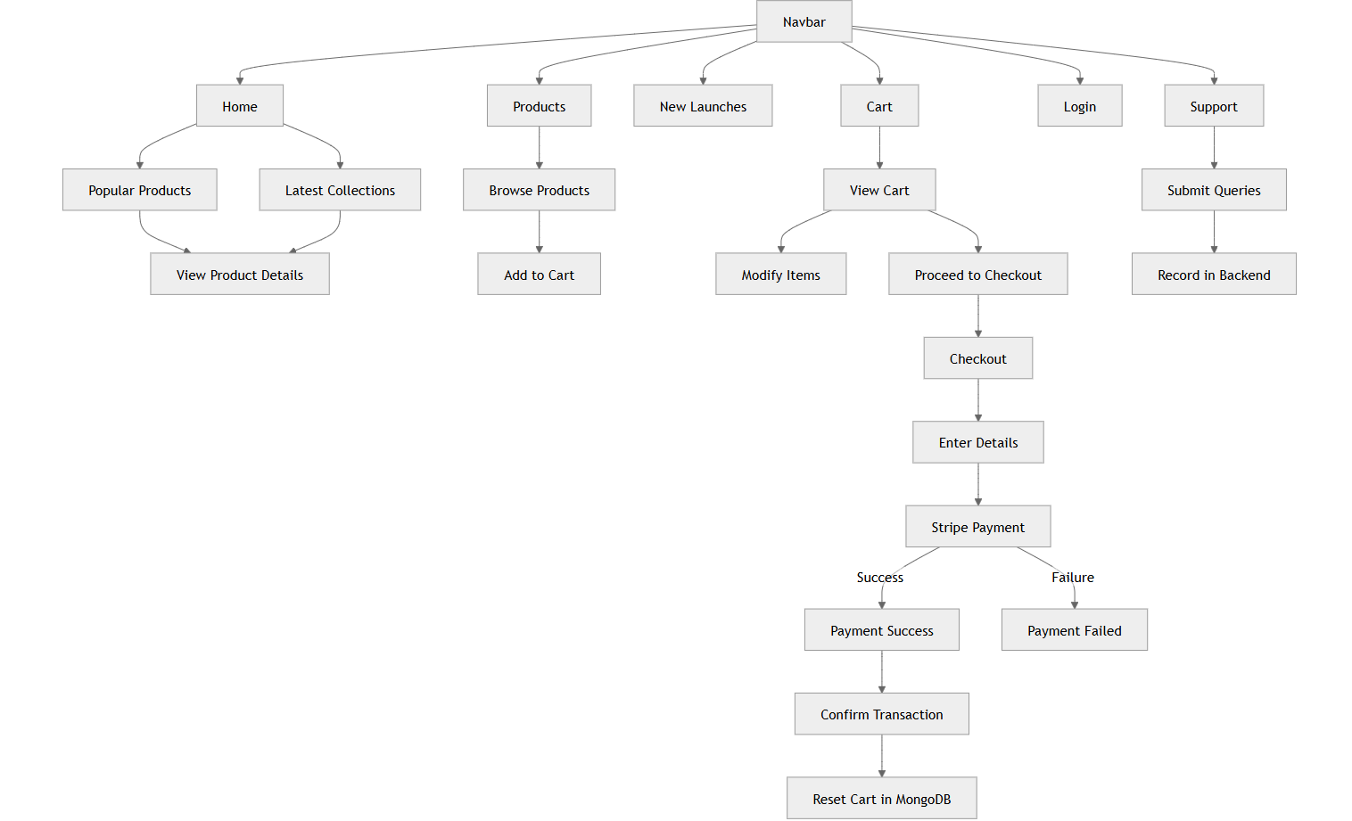
Object Oriented Diagrams (Flow Diagram)

Slide 10
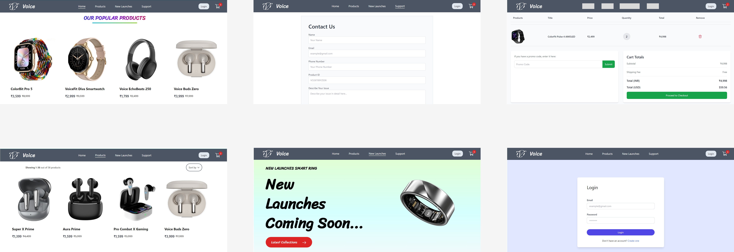
Wireframe

Slide 11
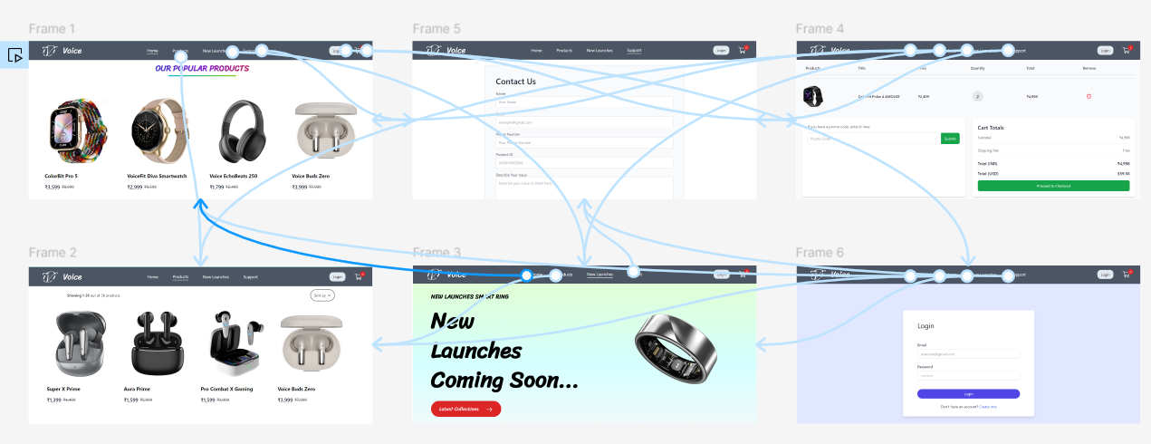
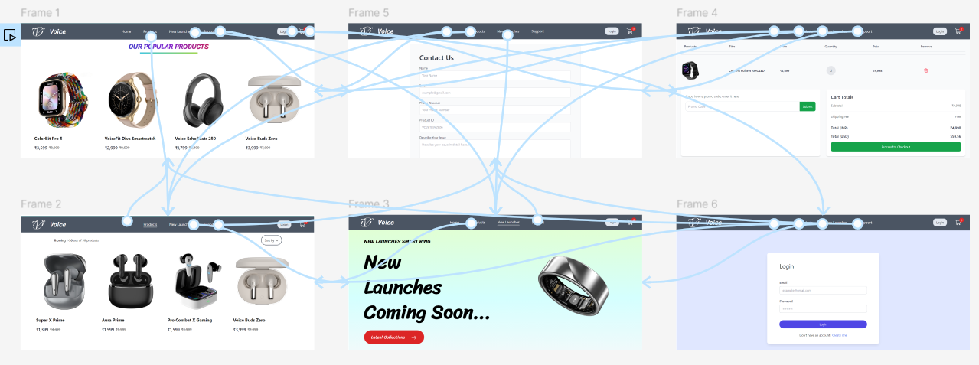
Wireframe

Slide 12
Tools & Technologies used
Frontend: React, Tailwind CSS, Daisy UI
Backend: Node.js, Express.js
Database: MongoDB
Authentication: JWT (JSON Web Tokens)
Cloud: Cloudinary (for image uploads)
Payment Gateway: Stripe
Version Control: GitHub, Git

Slide 13
Worked carried out till date
Completed user authentication with JWT tokens.
Built the frontend UI using React, integrated with Tailwind CSS.
Developed backend APIs for product management and cart operations.
Integrated Stripe payment gateway.
Cart operations are fully functional with real-time updates in MongoDB.
Admin panel for product management is in progress.

Slide 14
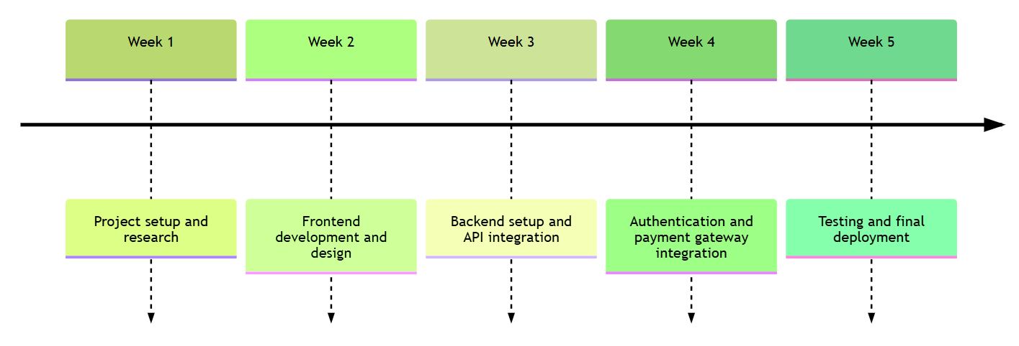
Timeline Chart (Gantt chart)

Slide 15
Conclusion
"Voice" is a feature-rich e-commerce platform that combines a modern tech stack (MERN) with industry-standard secure payment and user authentication practices. Its focus on TWS headphones and smartwatches, combined with a user-friendly interface, makes it a competitive solution in the fast-evolving e-commerce landscape.

Slide 16
Future Work
Implement advanced filtering for search functionality.
Add a personalized recommendation engine.
Enhance security for user authentication.
Making Website responsive for mobile devices.

Slide 17
References
https://docs.stripe.com/api
https://jwt.io/introduction
https://www.mongodb.com/docs/
https://react.dev/
https://daisyui.com/docs/
https://tailwindcss.com/docs

Slide 18
Thank You..!
Any Questions?

